Slide 1




Prompt
Engineering
The Art of Talking to LLMs
Presented by: Mr. Himanshu Tyagi

Slide 2




SHOW OF HANDS
How many of you have used / heard about ChatGPT?
1
How many of you have used it to just copy assignments?
2
3
What exactly is ChatGPT?

Slide 3








The evolution!
1
3
5
7
2
4
6
1950s-1980s
2000s-2010s
2017-Now
Future
Rule Based AI
(Heuristic systems)
Deep Learning
(Neural Networks)
Transformers & LLMs
(GPT, BERT, T5)
AGI (General Intelligence)
1980s-2000s
2014-2017
2020s-Now
Machine Learning
(Pattern understanding)
Natural Language Processing
(NLP)
Generative Al
(ChatGPT, Gemini, DALL.E, Runway, Eleven Labs)

Slide 4

LLM knows the whole internet, how do we direct it to do something specific?
via
Prompt

Slide 5


THE PROBLEM OF AMBIGUITY
Q. Let’s do something fun.
What will you recommend?
Because the question was ambiguous, The responses are as good as the questions!
Q. Let’s do something fun this evening, I have 2 hours of free slot & don’t want to eat junk!
This time the responses would be much closer / similar to each other because of explicit question.
Right Question → Expected answer
Right Prompts → Expected responses from LLM.

Slide 6
The art of “Right Prompts”
Prompt Engineering
1
Foundational principles of prompt design
2
Tactics to improve accuracy, control, and relevance
3
Common mistakes and how to fix them
4
Examples and exercises you can reuse in your work
5
Be creative & open minded

Slide 7
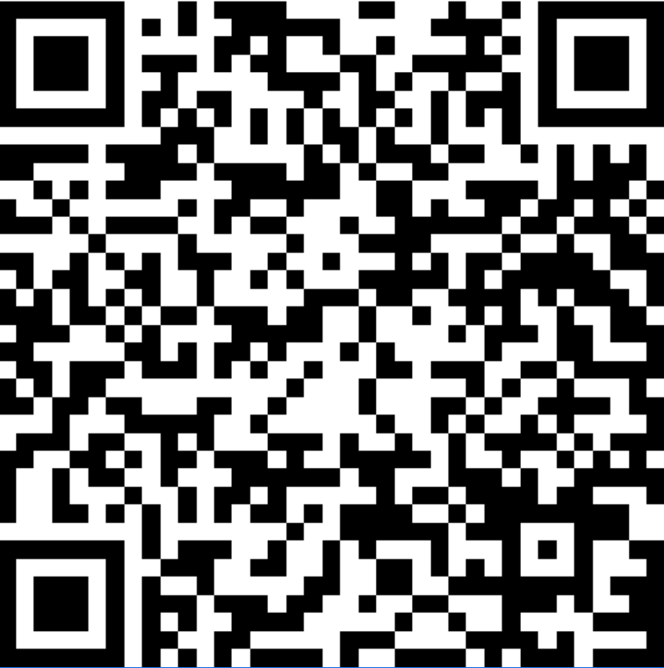
Download the collaterals here.

Slide 8


